Slide 1


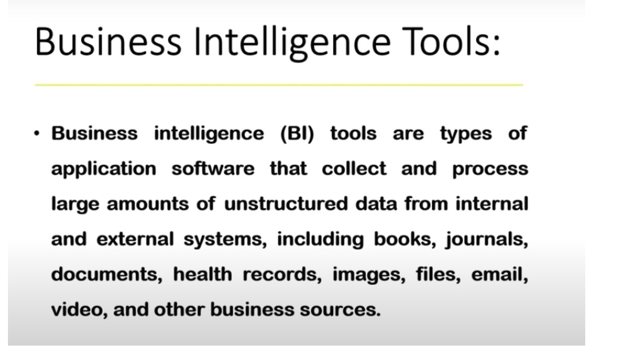
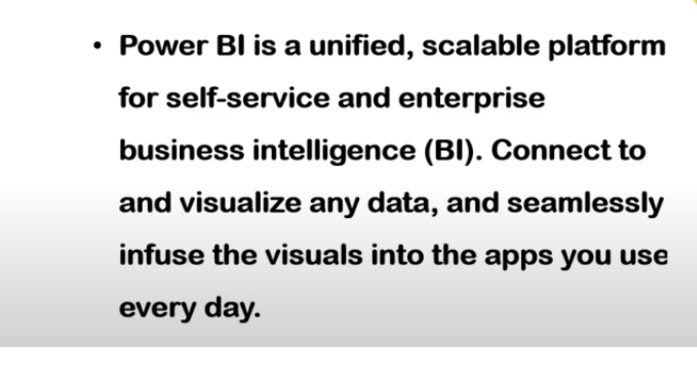

Slide 2
“Features of Power BI”.
Monthly Product Updates.
Extract insights from large datasets.
Create custom visualizations with R and Python.
Analyze your datasets in Excel.
Create beautiful maps with your data.
Easily source and transform data with Power Query.
Automatic data refreshes.
Power BI Mobile App.
Re-use datasets across different reports and dashboards
Powerful integration with other Microsoft Products (varies)

Slide 3
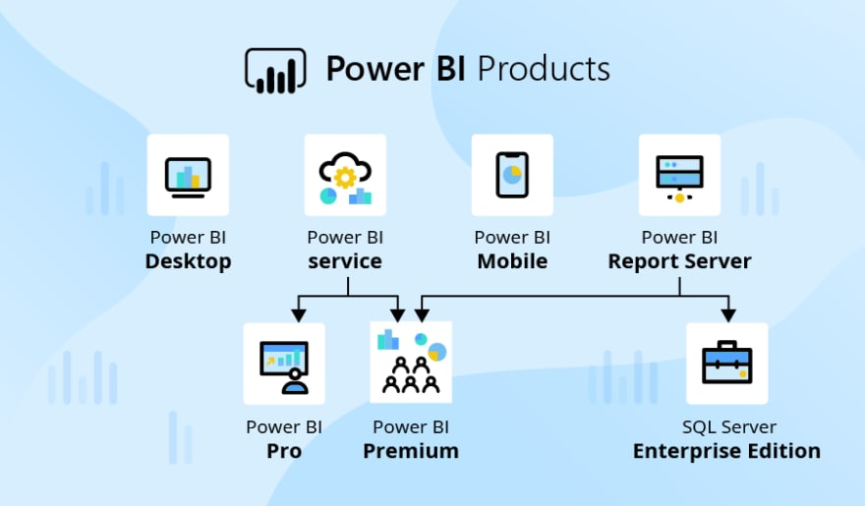
( Power Bi – “Products”)

Slide 4
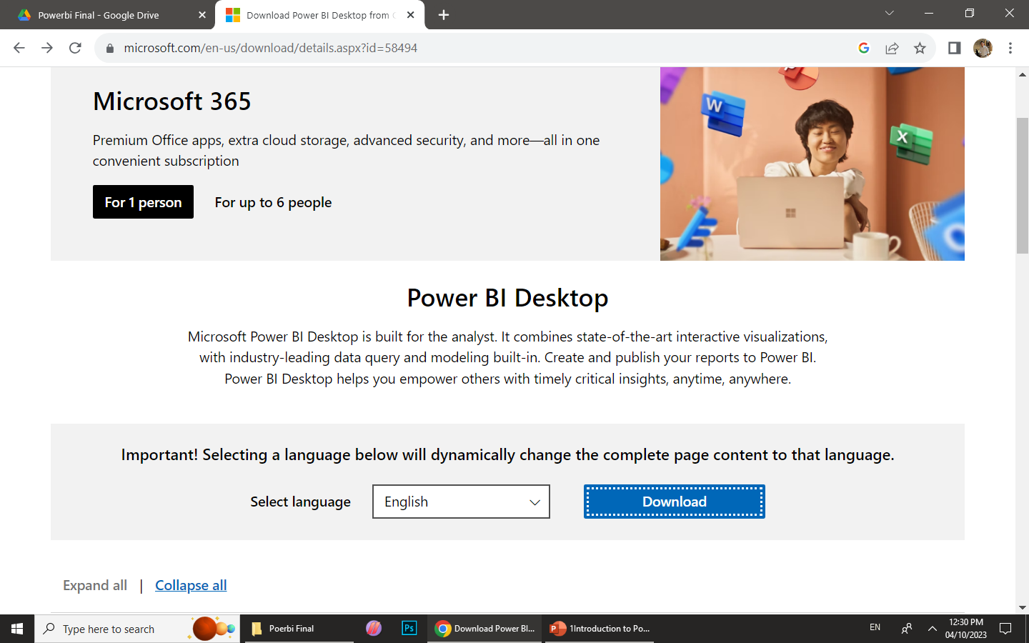
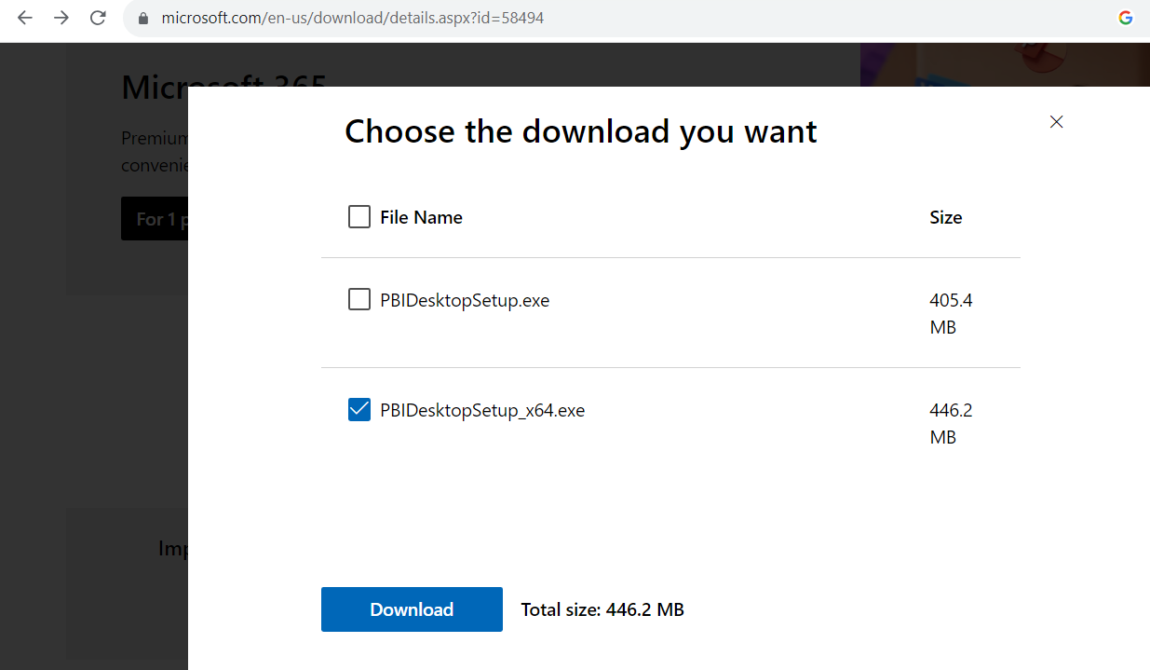
Installation of powerbi desktop
Download link https://www.microsoft.com/en-us/download/details.aspx?id=58494

Slide 5
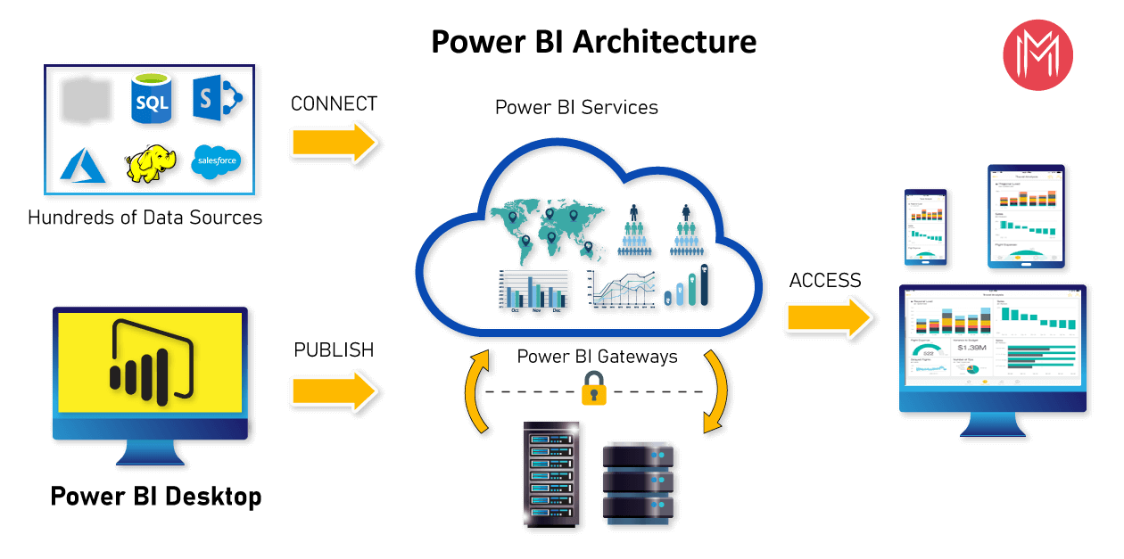
“Architecture of Power BI”.

Slide 6
“Power BI Career Opportunities”
Power BI Data Analyst.
Power BI Developer.
Power BI Analyst.
Power BI Business Analyst (IT).

